Slide 1

Understanding California's Earthquakes
Mohammad AlAdwani

Slide 2
Problem Statement
Earthquake prediction has long been the holy grail for seismologists around the world. The various factors affecting earthquakes are far from being understood, and there exist no known correlations between large- scale earthquake activity and periodic geological events.
The goal of this project is to say something about earthquakes’ locations, times or magnitudes from fault lines.

Slide 3
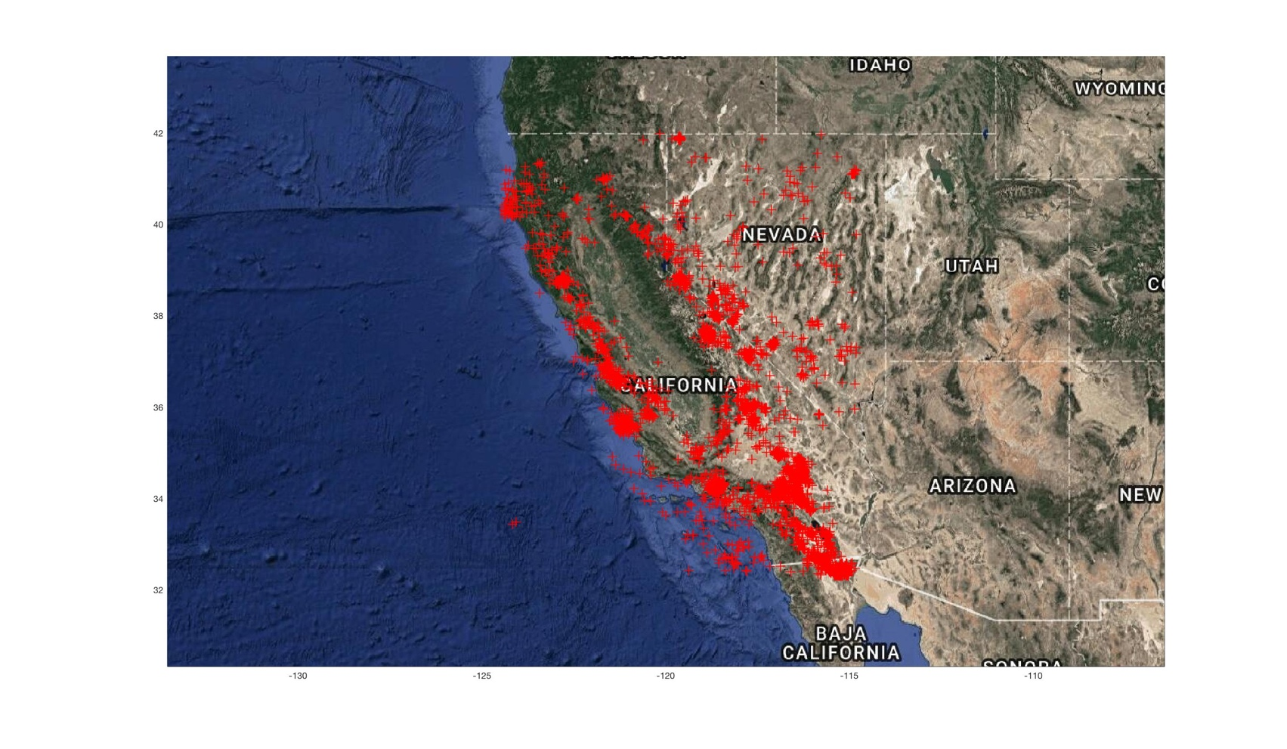
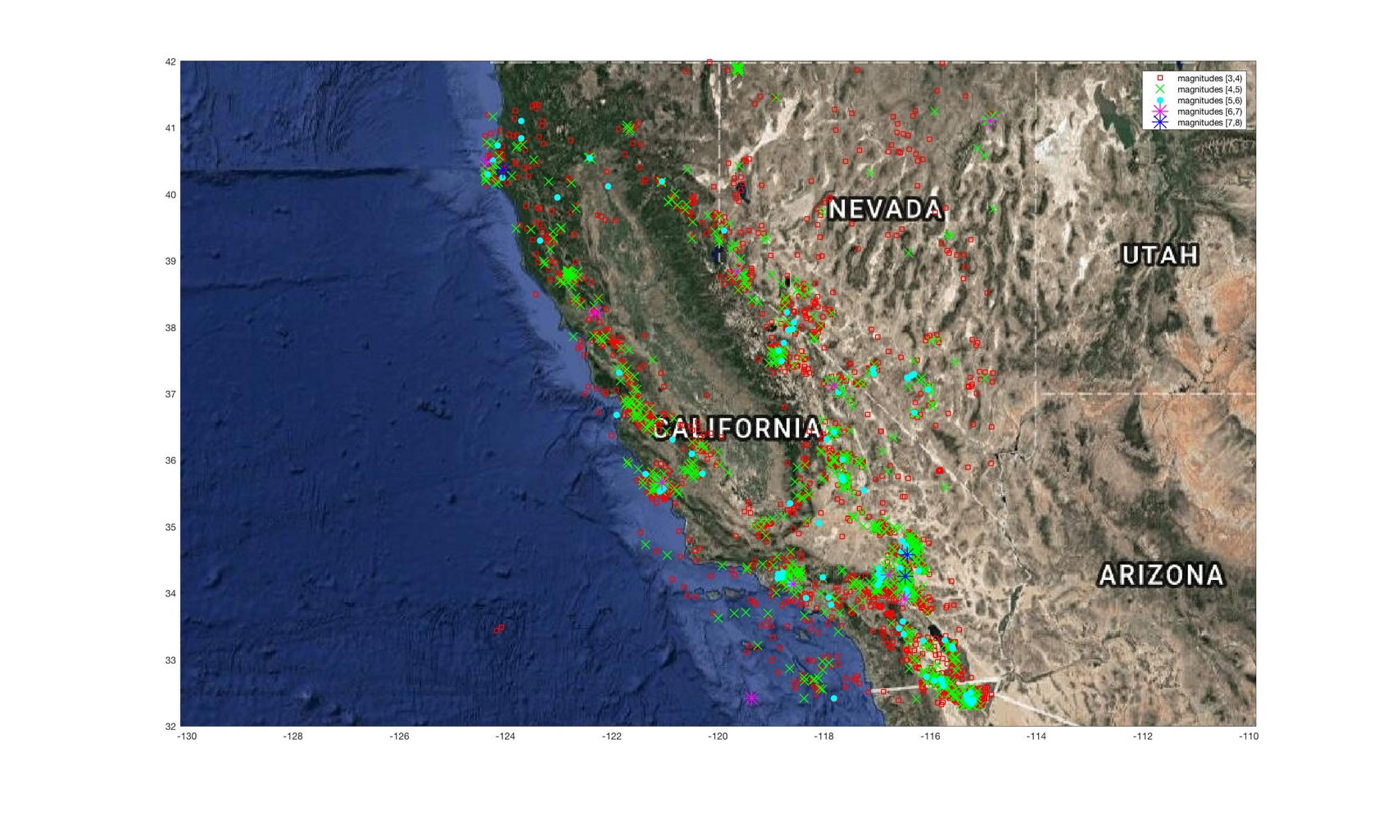
Figures: Earthquake Locations & Magnitudes
Figure 1. Earthquake locations in California
Figure 2. Earthquake locations in California
with magnitude coloring

Slide 4
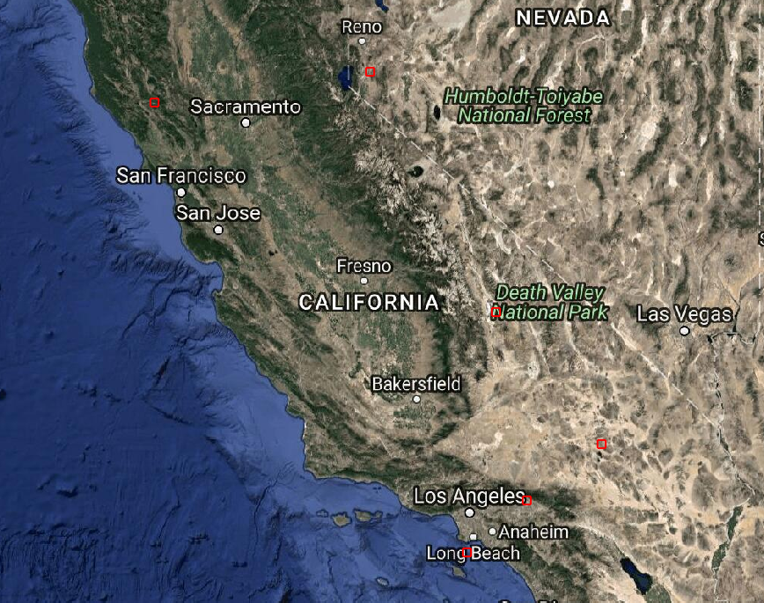
Video: Time-series plot of Earthquakes (1990-2015)

Slide 5
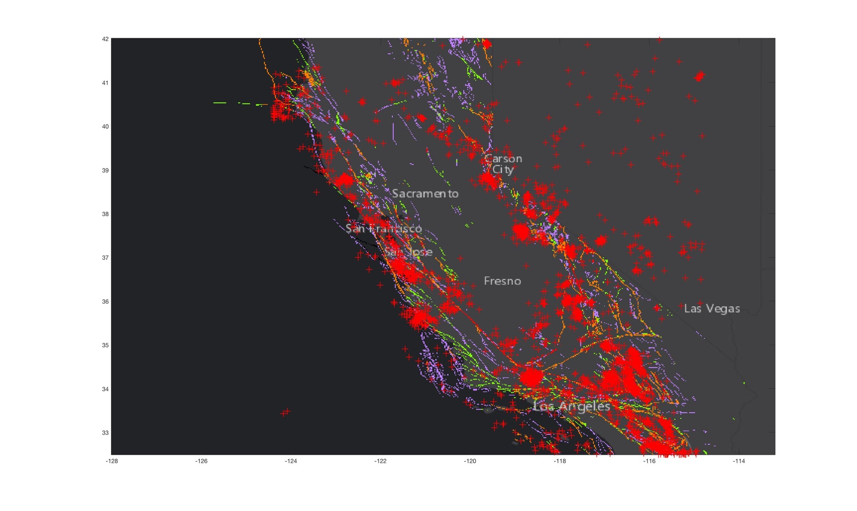
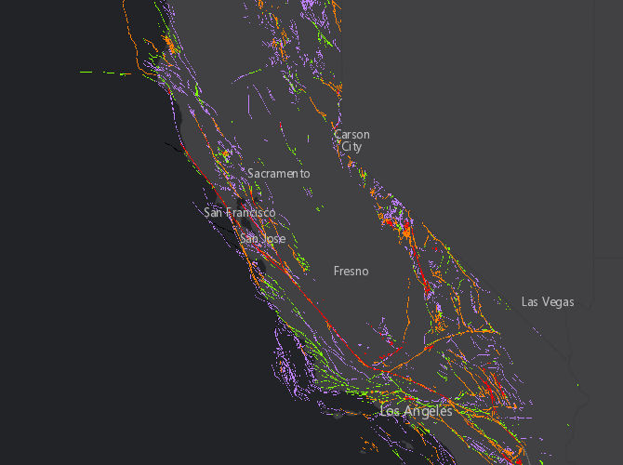
Figures: Fault Map & Earthquakes Locations
Figure 3. Fault Map of California
Figure 4. Earthquake locations over California’s Fault map

